Slide 1


Storytelling Case Study: Airbnb, NYC
Vivek Sharma

Slide 2
Agenda
Objective
Background
Key Findings
Recommendations
Appendix:
Data Attributes
Data Methodology
Data Assumptions

Slide 3
Objective
Airbnb is an online platform using which people can rent their unused accommodations.
During the covid time, Airbnb incurred a huge loss in revenue.
People have now started travelling again and Airbnb is aiming to bring up the business again and e ready to provide services to customers.

Slide 4
Background
For the past few months, Airbnb has seen a major decline in revenue.
Now that the restrictions have started lifting and people have started to travel more, Airbnb wants to make sure that it is fully prepared for this change.
So, analysis has been done on a dataset consisting of various Airbnb listings in New York.

Slide 5
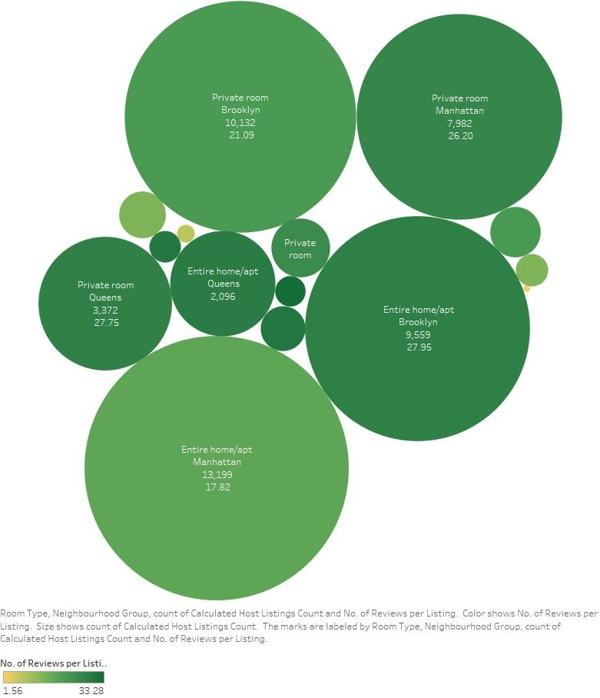
Neighbourhood Wise Business
Distribution
🞇 Private rooms are the most popular throughout New York >25 reviews per listing
🞇 Entire home/apt in Manhattan has reviews per listing 35% less than the average of 27.7
🞇 Except Manhattan, all areas performed poorly in shared rooms with an average of 7.3 reviews per listing

Slide 6
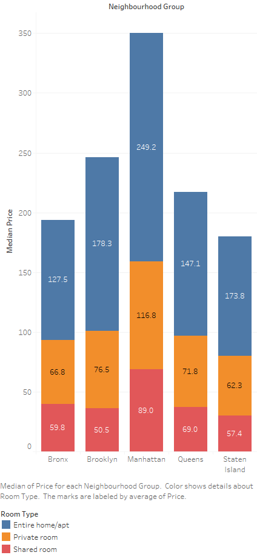
Pricing in Preferred Locations
🞇 Entire home/apt’s price is ~100% more than private rooms except Brooklyn and Staten Island with
~150%
🞇 Private room’s price is ~10% more than shared rooms except Brooklyn and Manhattan with ~40%
🞇 Manhattan is costliest overall and the cheapest are:
Entire apt: Bronx
Private room: Staten Islands
Shared room: Brooklyn

Slide 7
Recommendations
Acquire private rooms and entire apartments, especially in Staten Islands since it is popular
Reducing the prices of entire apartments in Manhattan by at least 15% and increasing the price of private rooms in Queens by at least 10%
Listings most popular have minimum number of nights requirement from 1-5 days and 30 days which should be showcased the most ordering them by properties which are available for number of days to least

Slide 8
Appendix: Data Attributes
Here is a snapshot of the data:
Host listing information like host name, neighbourhood, latitude and longitude
Customer preference information like number of reviews and number of reviews per month

Slide 9
Appendix: Data Methodology
Used Tableau to visualize correctly to get insights
🞇Since outliers existed in price field, used median of price instead of mean for analysis purposes
Find detailed methodology

Slide 10
Appendix: Data Assumptions
🞇 Used Reviews per Listing as the popularity measure to gain information on customer preferences
🞇 Number of reviews assumed to be a base
measure to find customer preferences
🞇 Null values assumed to have no material impact on analysis

